Slide 1
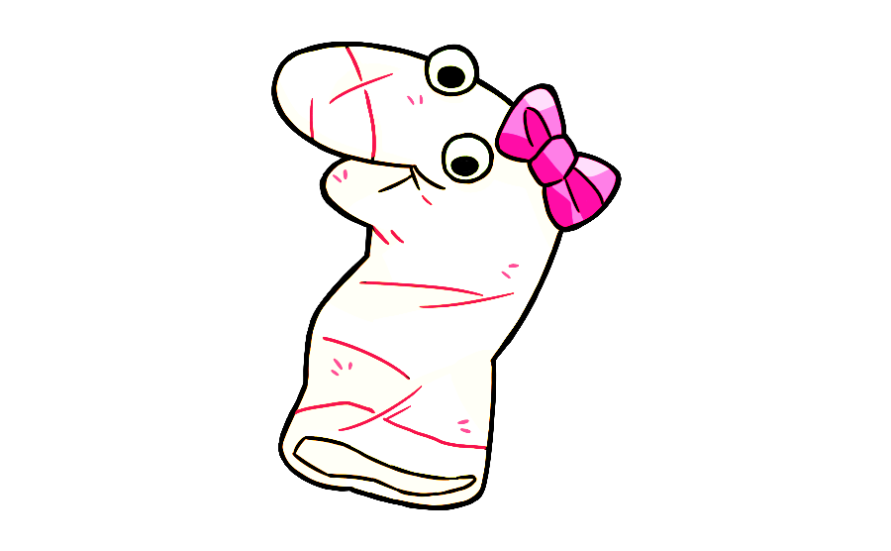
This is my friend Maggie. Say hi to Maggie. She is learning to speak puppet language and needs your help. Would you like to help Maggie learn to speak puppet language?
OK great! Are you ready to help her learn puppet language?

Slide 2
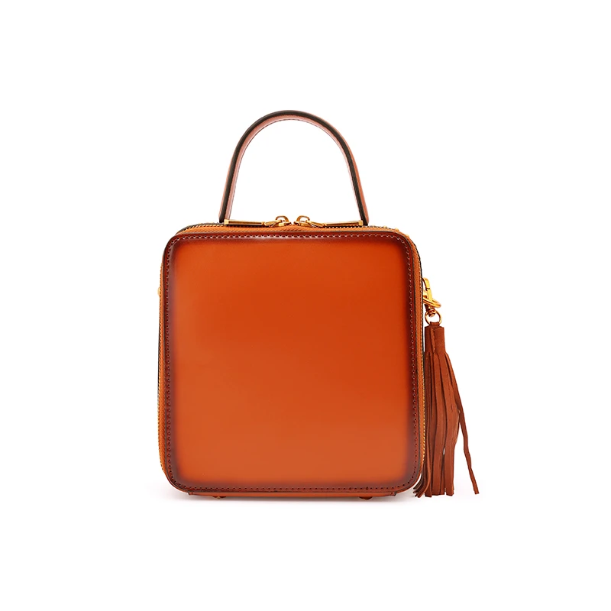
See this? This is a zulu. Zulus are for carrying things in.
Notes:
Click when saying see this—it will wiggle

Slide 3

See this? It is for watching.
Notes:
Click when saying see this—it will wiggle

Slide 4
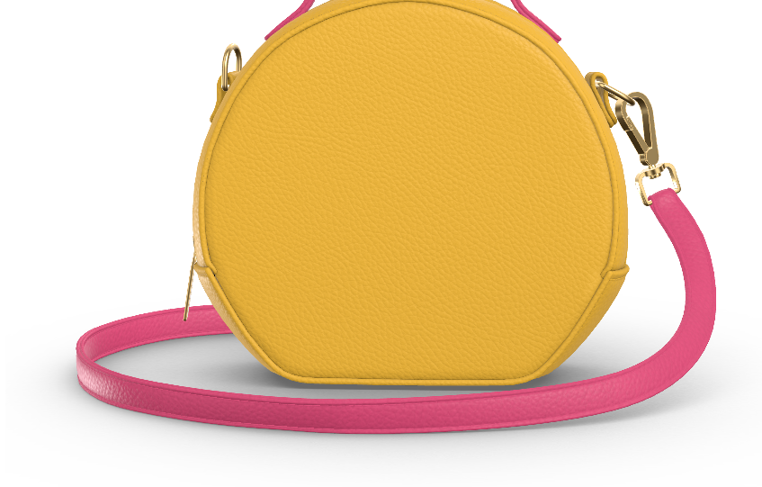
See this? It is for carrying things in.
Notes:
Click when saying see this—it will wiggle

Slide 5
Notes:
Question: See this zulu (click)? Can you find another zulu? Is it this one on top (click) or this one on bottom (click)?

Slide 6


Thanks for helping Maggie! Let’s help her learn some more puppet language.

Slide 7
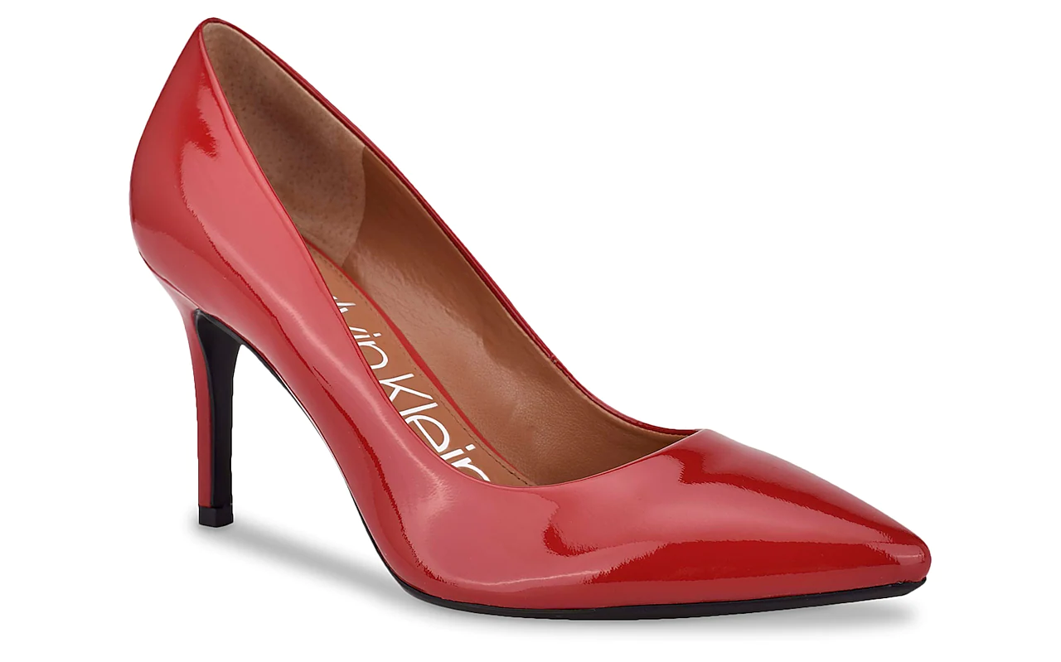
See this? This is a mupa. Mupa is for wearing.
Notes:
Click when saying see this—it will wiggle

Slide 8
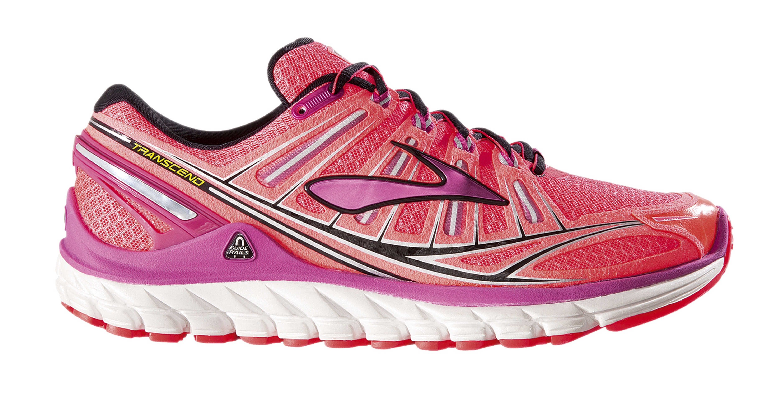
See this? It is for wearing.
Notes:
Click when saying see this—it will wiggle

Slide 9
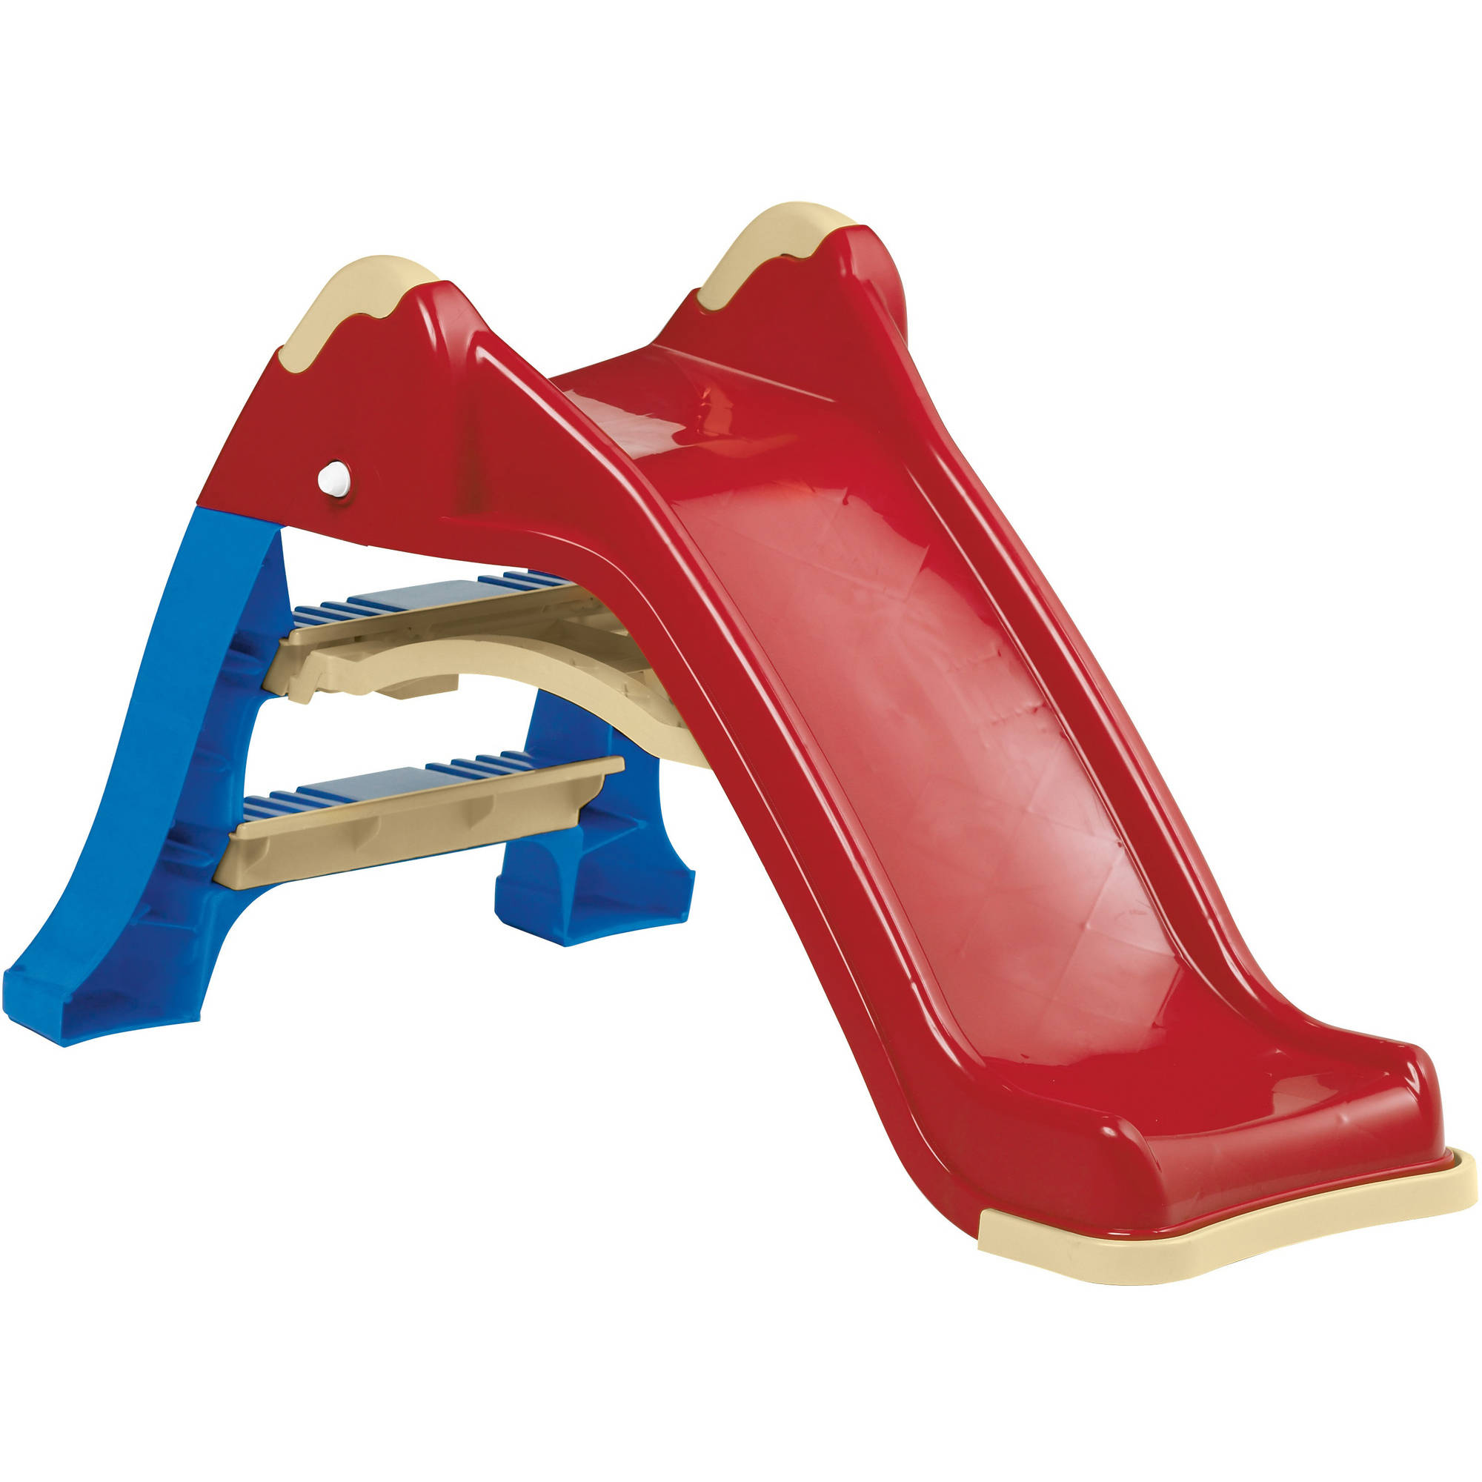
See this? It is for sliding down.
Notes:
Click when saying see this—it will wiggle

Slide 10
Notes:
Question: See this mupa (click)? Can you find another mupa? Is it this one on top (click) or this one on bottom (click)?

Slide 11
Thanks for helping Maggie! Let’s help her learn some more puppet language.

Slide 12
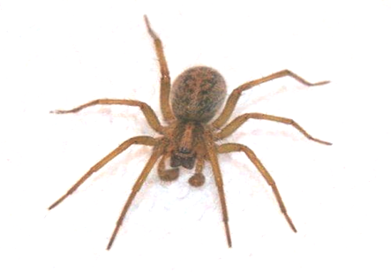
See this? This is a wubble. Wubbles are for making webs.
Notes:
Click when saying see this—it will wiggle

Slide 13
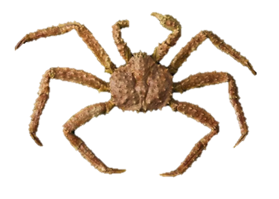
See this? It is for swimming.
Notes:
Click when saying see this—it will wiggle

Slide 14
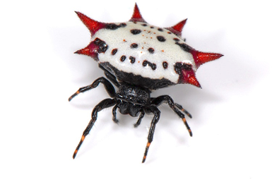
See this? It is for making webs.
Notes:
Click when saying see this—it will wiggle

Slide 15
Notes:
Question: See this wubble (click)? Can you find another wubble? Is it this one on top (click) or this one on bottom (click)?

Slide 16

See this? This is a hudi. Hudis are for birds to live in.

Slide 17
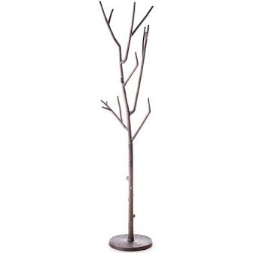
See this? It is for hanging your coat.

Slide 18
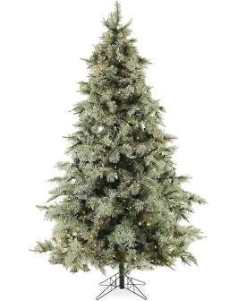
See this? It is for birds to live in.

Slide 19
Notes:
Question: See this hudi (click)? Can you find another hudi? Is it this one on top (click) or this one on bottom (click)?

Slide 20
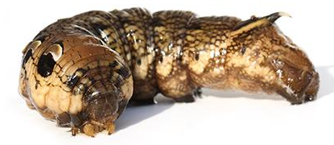
See this? This is a miko. Mikos are for eating leaves.
Notes:
Question: See this miko (click)? Can you find another miko? Is it this one on top (click) or this one on bottom (click)?

Slide 21
See this? It is for breakfast.
Notes:
Question: See this miko (click)? Can you find another miko? Is it this one on top (click) or this one on bottom (click)?

Slide 22
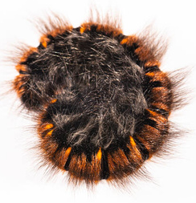
See this? It is for eating leaves.
Notes:
Question: See this miko (click)? Can you find another miko? Is it this one on top (click) or this one on bottom (click)?

Slide 23
Notes:
Question: See this miko (click)? Can you find another miko? Is it this one on top (click) or this one on bottom (click)?

Slide 24

See this? This is a vemo. Vemo are for telling time.
Notes:
Question: See this vemo (click)? Can you find another vemo? Is it this one on top (click) or this one on bottom (click)?

Slide 25

See this? It is for playing music.
Notes:
Question: See this vemo (click)? Can you find another vemo? Is it this one on top (click) or this one on bottom (click)?

Slide 26
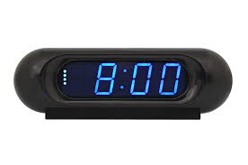
See this? It is for telling time.
Notes:
Question: See this vemo (click)? Can you find another vemo? Is it this one on top (click) or this one on bottom (click)?

Slide 27
Notes:
Question: See this vemo (click)? Can you find another vemo? Is it this one on top (click) or this one on bottom (click)?

Slide 28
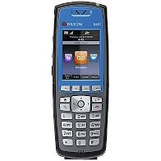
See this? This is a gerp. Gerps are for calling people.
Notes:
Click when saying see this—it will wiggle

Slide 29
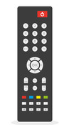
See this? It is for turning on your tv.
Notes:
Click when saying see this—it will wiggle

Slide 30
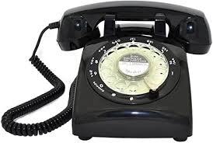
See this? It is for calling people.
Notes:
Click when saying see this—it will wiggle

Slide 31
Notes:
Question: See this gerp (click)? Can you find another gerp? Is it this one on top (click) or this one on bottom (click)?

Slide 32
Thanks for helping Maggie! Let’s help her learn some more puppet language.
Notes:
Thanks so much for helping Maggie. We are halfway through the game. Lets keep going!

Slide 33
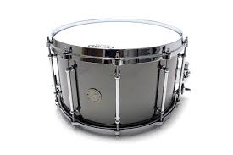
See this? This is a feld. Felds are for making music.
Notes:
Question: See this feld (click)? Can you find another feld? Is it this one on top (click) or this one on bottom (click)?

Slide 34
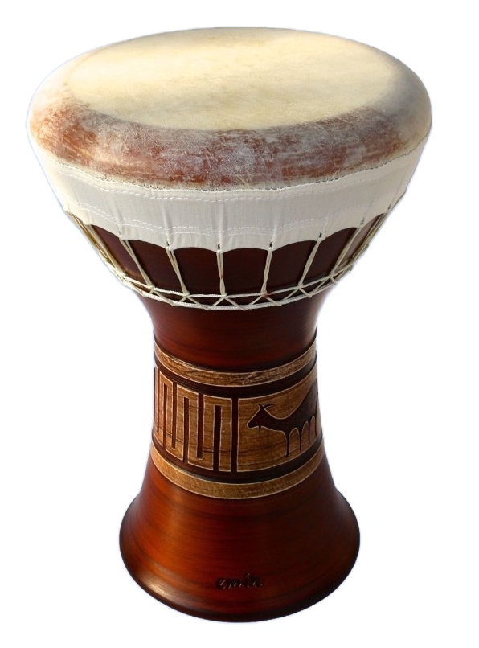
See this? It is for making music.
Notes:
Question: See this feld (click)? Can you find another feld? Is it this one on top (click) or this one on bottom (click)?

Slide 35
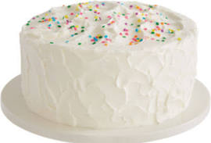
See this? It is for eating at a birthday party.
Notes:
Question: See this feld (click)? Can you find another feld? Is it this one on top (click) or this one on bottom (click)?

Slide 36
Notes:
Question: See this feld (click)? Can you find another feld? Is it this one on top (click) or this one on bottom (click)?

